Slide 1

AlphaCab – Sprint 1
ESD UFCF85-30-3
Group members:
- Fatma Aljarah - Sara Alrahbi
- Huda Altubi - Ameera Albattashi
- Amina Alkhatri

Slide 2
Requirements:
For the team:
Establish a project schedule and determine each phase
Assign tasks to project team members
Documenting the process using GitHub
Comfortably and optimally identified roles
For the System:
Comfortable and optimal use of DB operations
Clear understanding of wider context of the knowledge with all relevant limits and implications

Slide 3
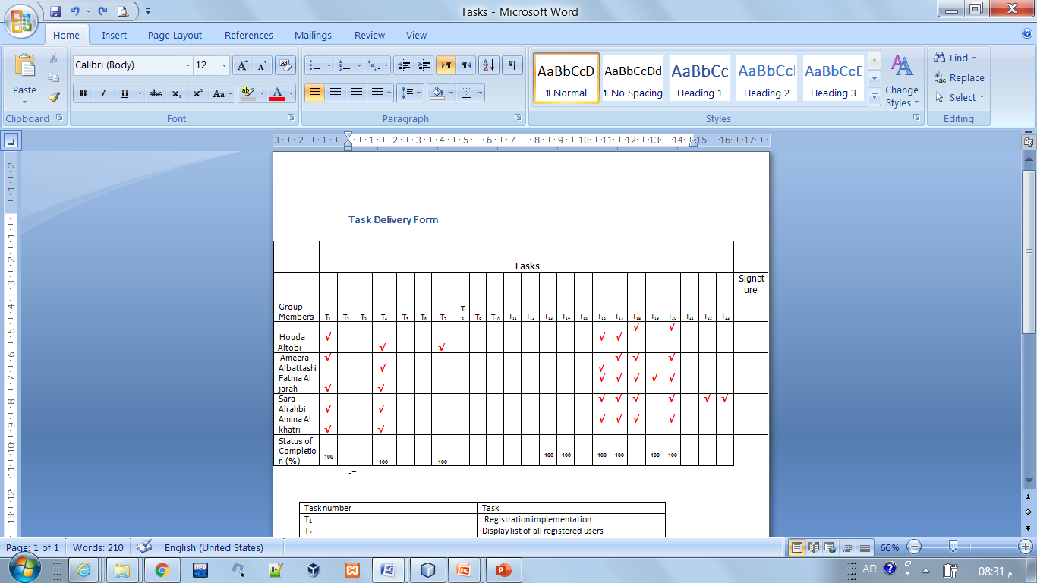
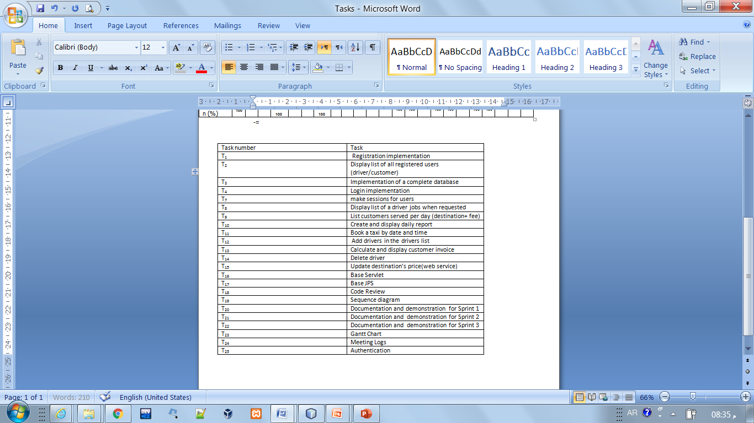
Task Delivery Form:

Slide 4
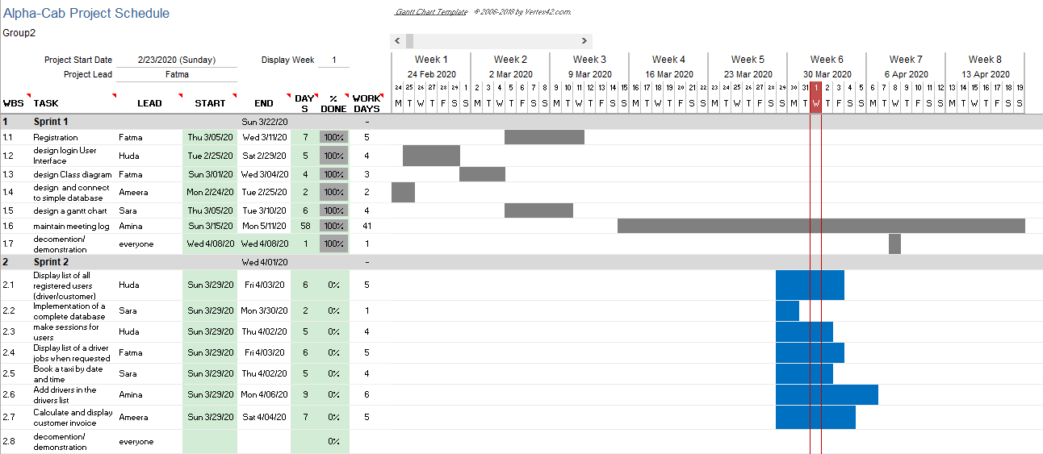
Workflow (Gantt Chart)

Slide 5
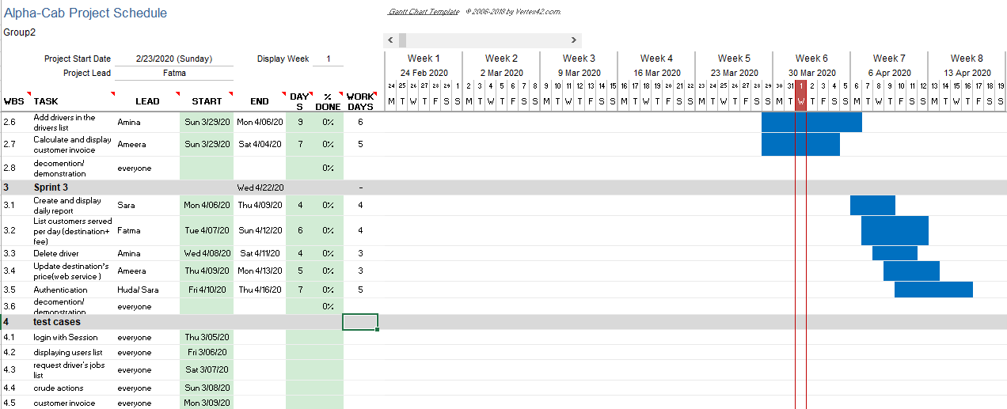
Workflow (Gantt Chart)2

Slide 6
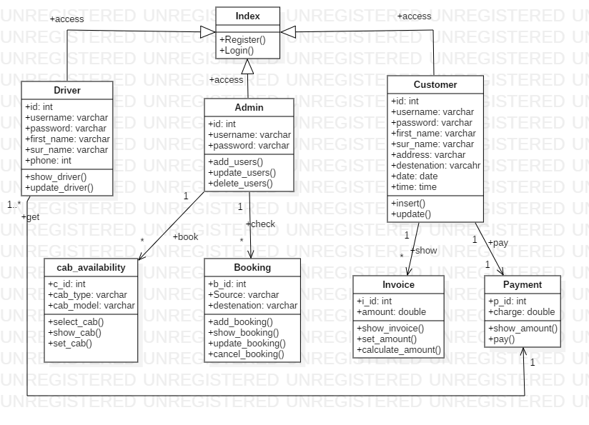
AlphaCab Class Diagram:

Slide 7
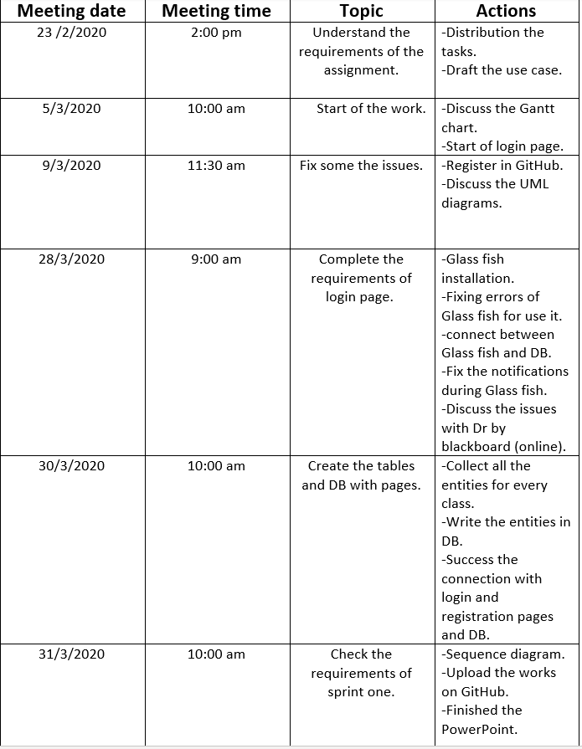
Meetings Log:

Slide 8
Sprint 1 challenges :
The errors in code that the team members faced.
Online meetings wasn’t as efficient as face-to face.
Glassfish server different versions
Hard to manage the libraries in the project.

Slide 9
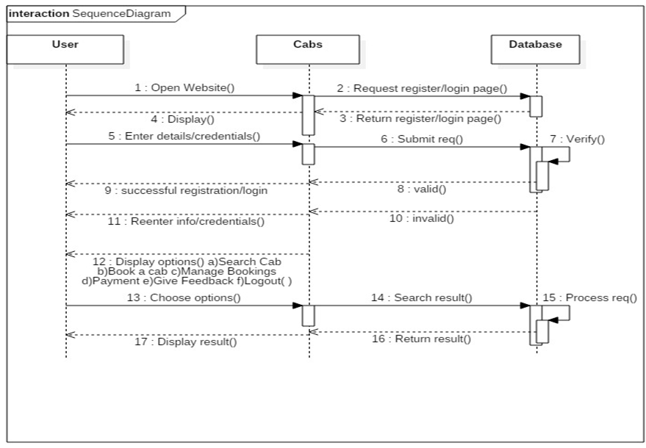
Login and Registration SD:

Slide 10
Testing:
Login/ registration > http requests page > display correct page
Login/ registration valid > successful > user accessed/ created
Login/ registration invalid > re-enter request information> form page returned

Slide 11
Demonstration
Login function

Slide 12
Questions!!

